Slide 1


Stock Market Analysis
Intermediate Analytics
Prof. Tenglong Li
Forum Bheda
Labdhi Ghelani
Mohita Sharma

Slide 2

Stock Market
Introduction
Stock Market is a place where shares of pubic listed companies are traded.
Investors buy shares in publicly traded companies and then sell those shares back.
There are many different strategies for investing, but the basic function of the stock market comes down to investors purchasing and selling previously existing shares on the New York Stock Exchange (NYSE), Nasdaq, or other stock exchanges.

Slide 3

Aim
Analyzing stock prices helps an intelligent trader to invest wisely in the stock market.
Seemingly endless data is available for Stock market. It is difficult to collect a large dataset of stock prices which is structured, cleaned and has high granularity.
To achieve our aim we have performed Data Analysis, Time series, Data Mining along with visualization.

Slide 4
Our Objective
Collect and clean large amount of data for the year 2014-2016 on both daily and annual basis.
Once it is cleaned, we have created a schema and stored it in the database (SQLite). We are using SQL database to store the data.
After the data is in the structured format, retrieve data using SQL queries.
We have also performed Data Visualization using R programming.
Additionally, performed ARIMA on highly volatile data.

Slide 5
Data Collection and Cleaning
We have collected data from 2 sources and followed extraction and manipulation on both the sources:
Kaggle NYSE and NASDAQ data
S&P Dow Jones Indices
Then we have performed the following three steps:
Web Scrapping of Data using import.io
Collecting Stock data:
We have collected data for listed 500 companies from source 1 for both daily basis and annual basis.
3. Data Cleaning:
It includes renaming, splitting and removing unwanted columns, performing missing value treatment, cleansing of the date column and factorizing it, normalizing column fields and creating new data frames for volume of stocks traded every month, day, year, weekday accordingly.

Slide 6
Data Storage
Once the data was collected and cleaned, next step was to create the data structure which follows 3rd Normal Form(3NF). 3NF is used in normalizing the database design to reduce the duplication of data and ensuring referential integrity.
We created 3 tables by establishing the connection with the RSQLite package.
Company Information: This table has company name, its location and its stock name.
Daily Stock Information: This schema has stock information on a daily basis such as open price, close price, lowest rate, highest rate and volume of the stock traded.
Annual Balance Information: This table has stock information on an annual basis such as Cash and Equivalent, Operating Margin, Retained Earnings, Investment, Assets, Liabilities, Total Revenue and Treasury Stock.

Slide 7
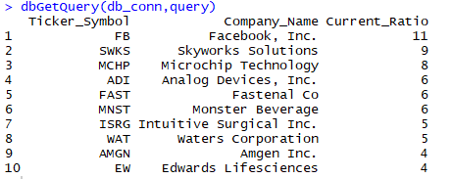
Data Retrieving
To transform structured data into meaningful information. We performed analysis by retrieving data using SQL queries.
1. Display the Companies having a current ratio greater than one.
Current ratio of Facebook is 11. Facebook has the highest
current ratio followed by Skyworks Solutions with a
current ratio of 9. Microchip Technology, Analog Devices, Inc.,
Fastenal Co, Monster Beverage, Intuitive Surgical Inc.,
Waters Corporation, Amgen Inc. and Edwards Lifesciences having
the current ratio of greater than one. It means these 10
companies have more assets than liabilities.
Note:
Current Ratio is a ratio of Total Current Assets to Total Current Liabilities.
If greater than 1, company has more assets than liabilities.
If less than 1, company has more liabilities which is not good.
If equal to 1, company has zero assets left.

Slide 8
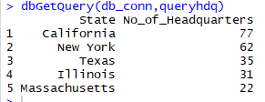
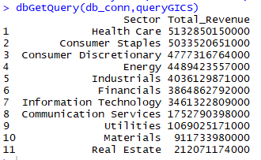
Data Retrieving
2. Which state has the highest number of headquarters?
California has the highest number of Headquarters i.e. 77,
which means maximum money flow from there.
New York is the second highest state with 62 no. of
headquarters followed by Texas, Illinois, and Massachusetts.
3. Display all the GICS Sector along with their Total revenue.
Among Sector, Health Care has the highest total revenue.
Consumer Staples is very near to Health Care.
Consumer Discretionary has the third highest Revenue.
Real Estate has the lowest revenue.

Slide 9
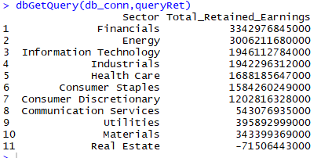
Data Retrieving
4. Display the Retained earnings for Industries
Financial Sector has retained earnings of
3342976845000. Financial Sector has the highest net
earning which is not paid out as dividends but retained
by the company to be reinvested in its core business
whereas Real Estate have the lowest retained earnings.

Slide 10
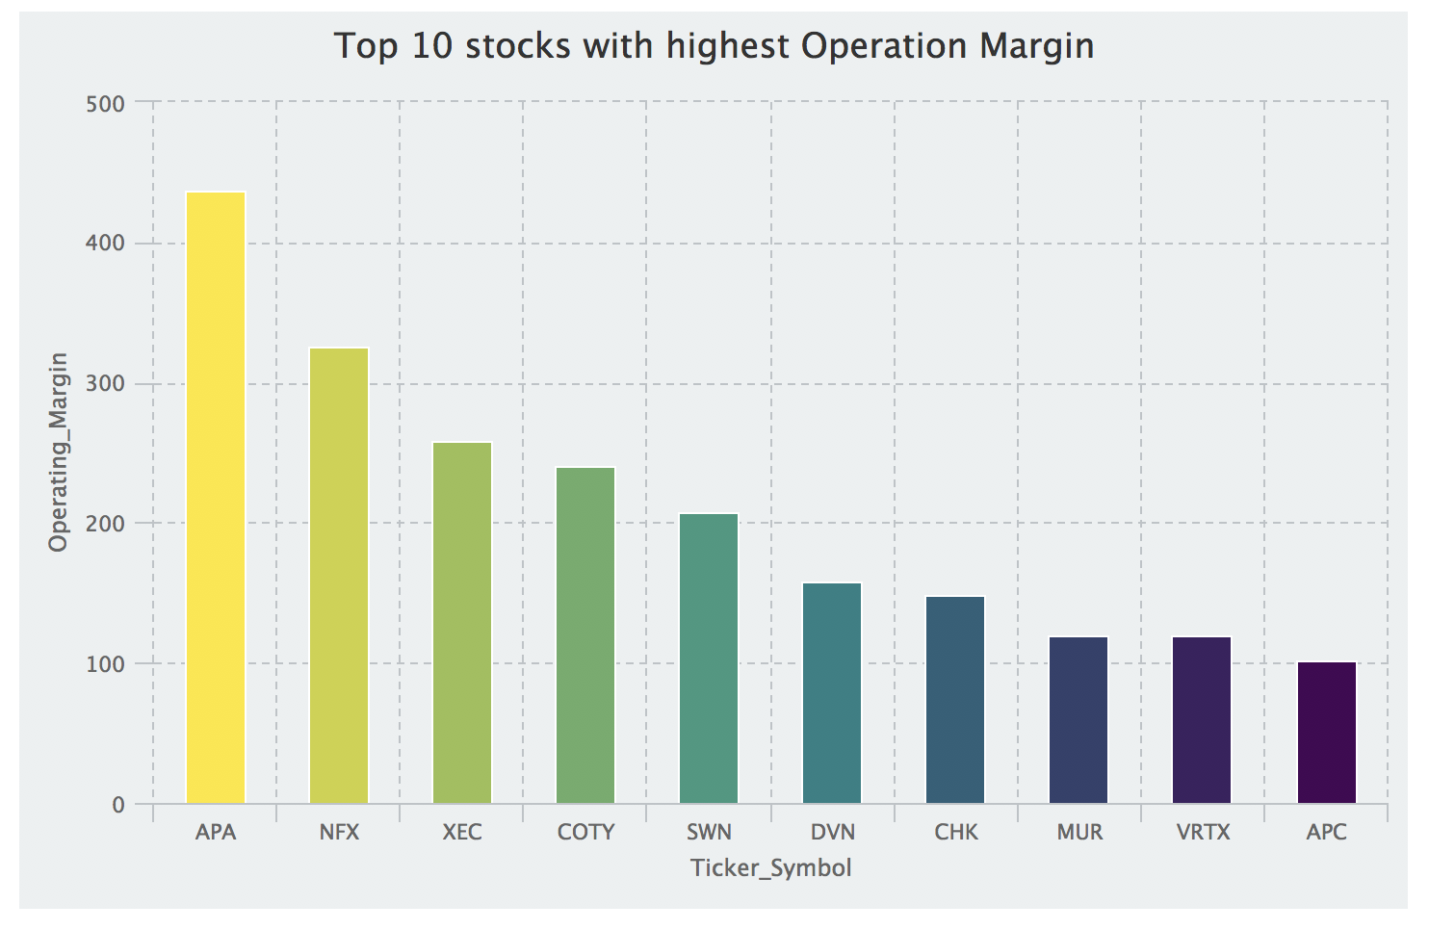
Data Visualization To perform advanced analysis, which gives more clarity in understanding the data. We have performed Data Visualization using R Libraries.
1. Plot a graph of how much a company makes on each dollar of sales [Operation Margin]
Operation Margin measures profitability.
APA stocks have the highest Operation Margin which says they earn the highest profit on each dollar of revenue. APA stocks belong to Apache Corporation.
Investing in APA stocks seems to be a safe bet for investors. The bar graph displays top 10 stocks having highest Operation Margin.

Slide 11
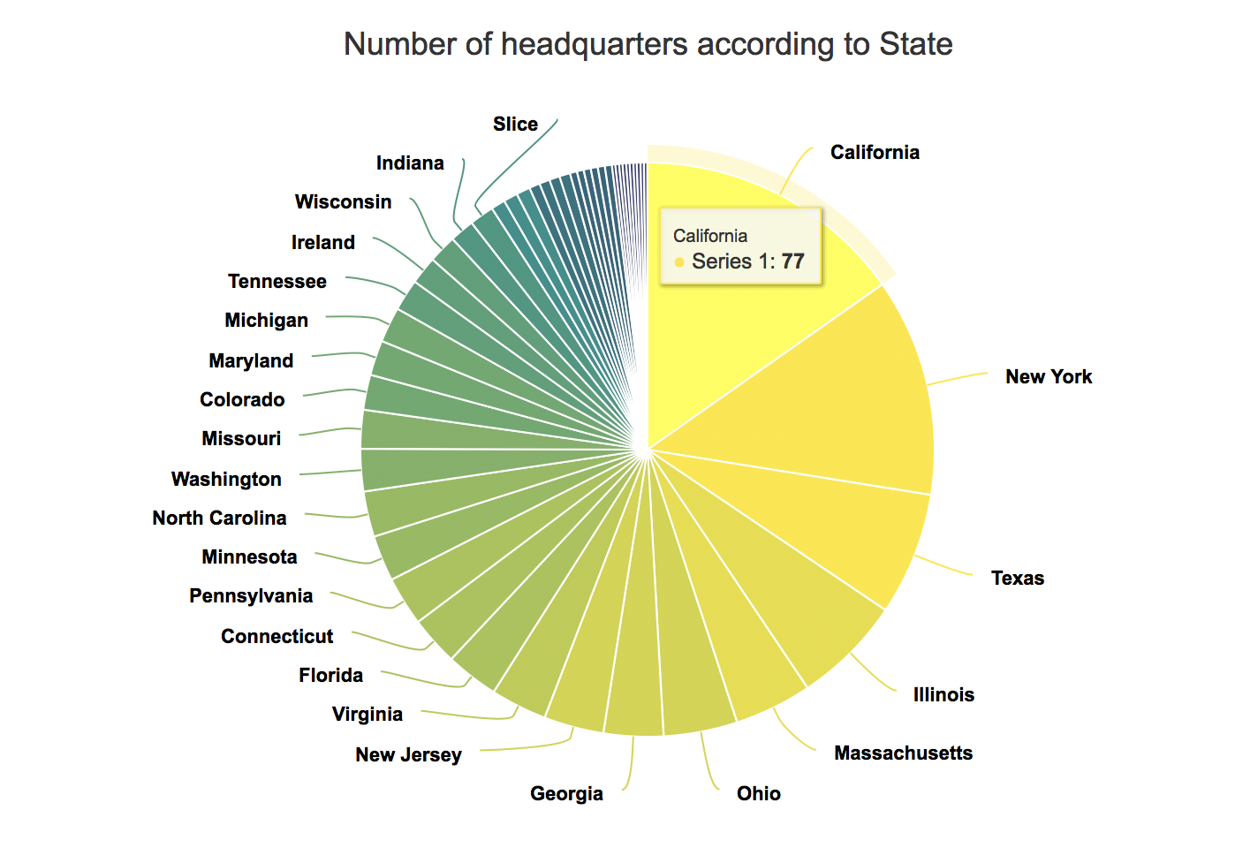
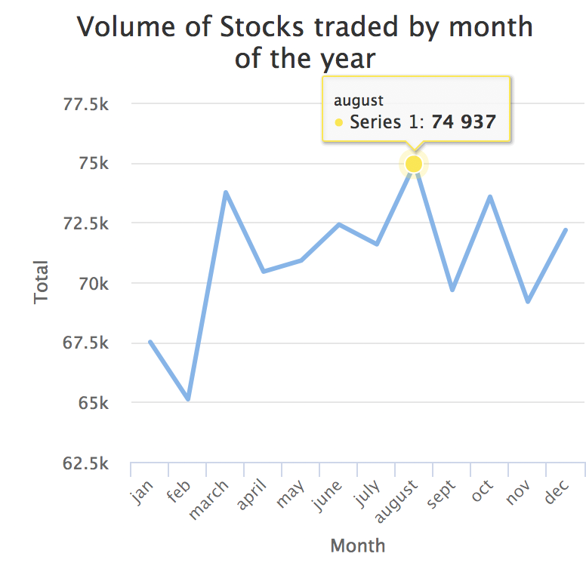
Data Visualization
2. Display the states and their headquarters. (Fortune 500 companies)
California has the 77 no. of headquarters from top 500 companies. Followed by New York, Texas, Illinois and Massachusetts. These are the top 5 states having the highest no of headquarters.
3. The volume of Stocks traded by Month
Line graph clearly shows that August has the highest volume of stocks i.e. 74937 whereas February has the lowest number of stocks i.e. 65114.
January, February doesn’t seem to be a good time at Stock Market being the start of the year. - The market seems to be very uncertain from September to December.

Slide 12
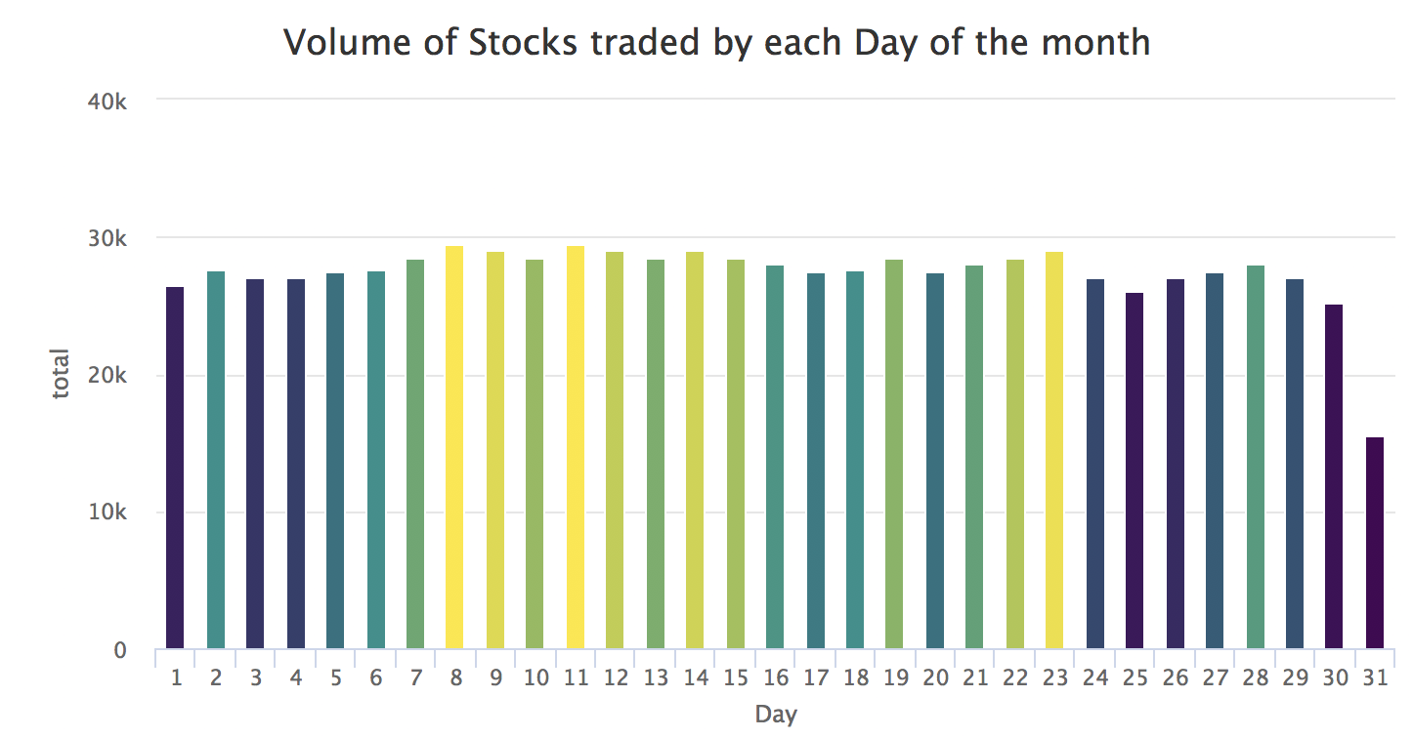
Data Visualization
4. The volume of Stocks traded by each day of the month
There is the highest peak in the middle of each month. There has been a record that on 11th of every month, the highest volume of stocks is traded.
Bars with yellow to green color says high volume of stocks has been traded, which is seen in the middle of every month. Whereas dark green to purple and blue says the low volume of stocks have been traded, which is seen in start and end of every month.
People get their salary at the start of every month and the first week usually they spend on clearing their dues which helps them give a clear idea on how much to invest. Thus, middle of the month is the time when people seem to invest in the stock market.

Slide 13
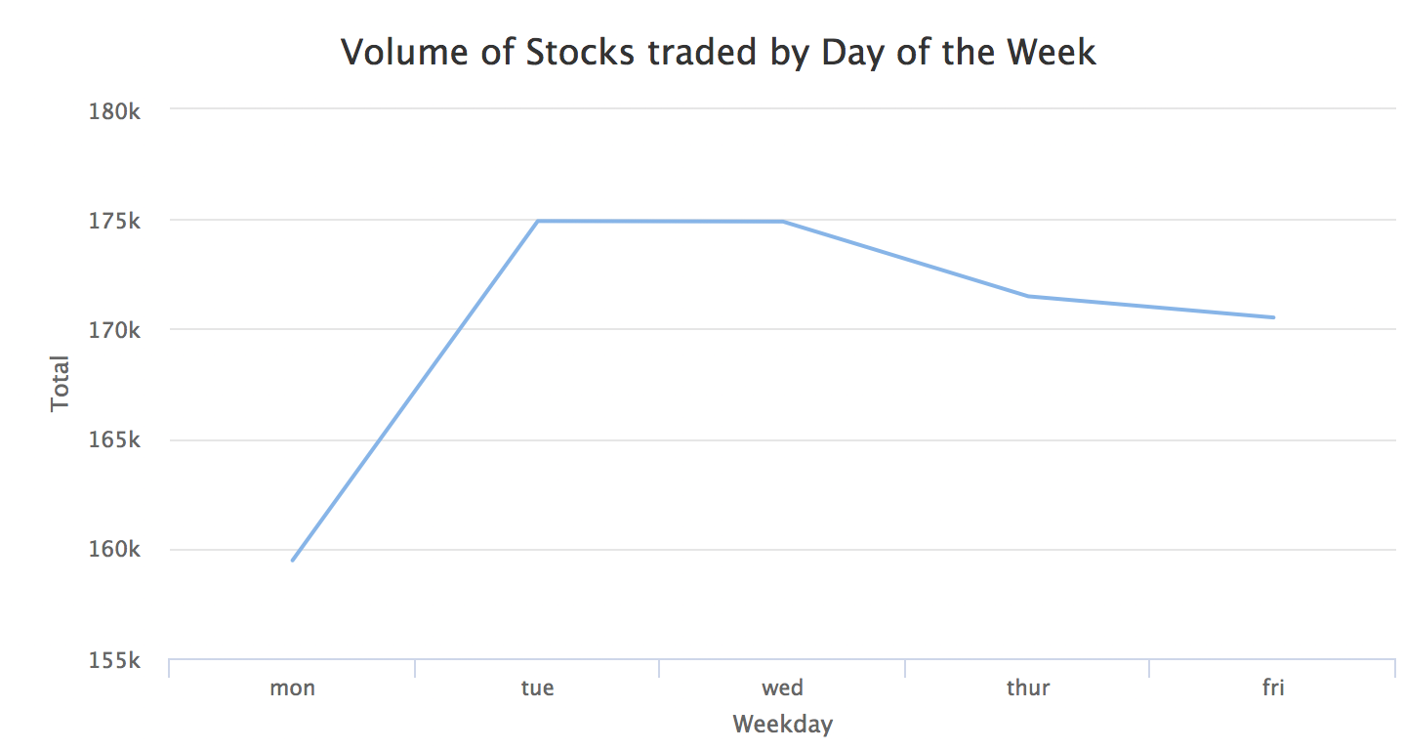
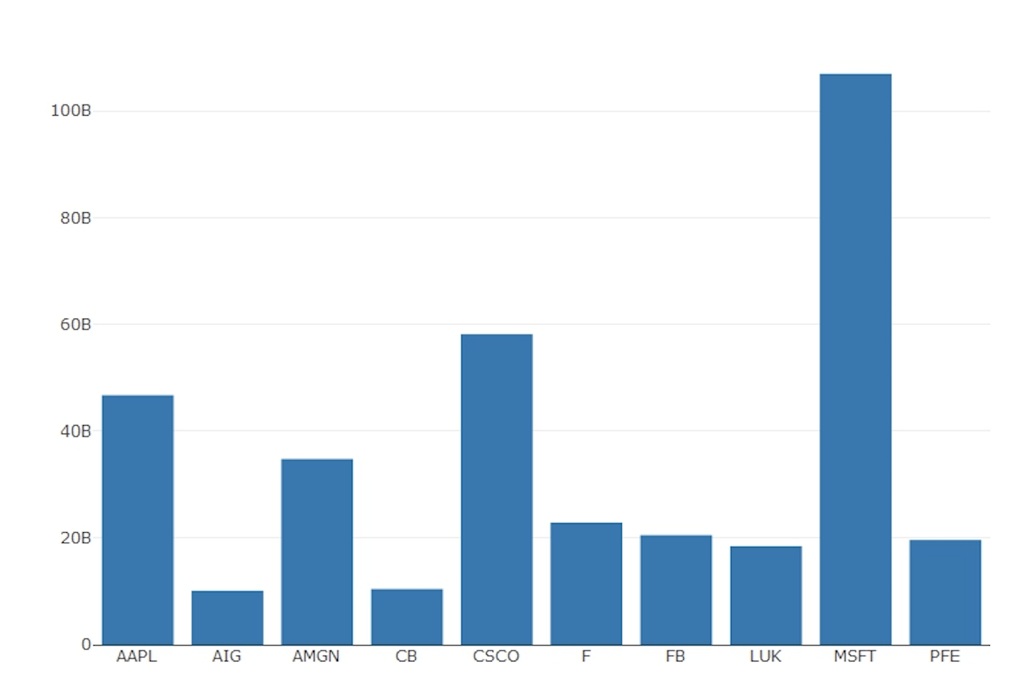
Data Visualization
5. The volume of Stocks traded by Weekday
Lowest volume of stocks are traded on Monday. As Monday is the first day of the week and it is also the busiest day of the week as well as Monday being the first day of the week for the stock market, the market is highly volatile thus making it unpredictable for investments. - The maximum volume of stocks is traded on Tuesdays and Wednesdays. Tuesdays and Wednesdays are comparatively more predictable. Hence it is the preferred choice for the investors.
6. Which companies have more Short-Term Investments Due compared to Cash and Cash Equivalent.
Short-Term Investments Due are the debts incurred by the company which is due within one year. This value helps in determining a company’s performance.
Companies with a high amount of cash and cash equivalents are better and show higher liquidity.
Thus, having less short-term investments due and higher cash & cash equivalents makes company stable and reliable to buy stocks.
The above bar graph shows top 10 companies which have more short-term investments due and less cash & cash equivalent, which makes them less reliable. This analysis can make investors think twice before buying their stocks

Slide 14
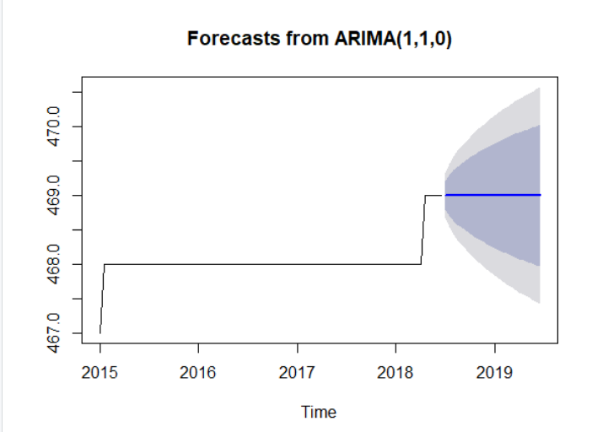
Forecasting/ Prediction Using the historical data, we are forecasting the volume of stocks traded for future years. We are predicting the data using package timeseries. It tries to forecast and build ARIMA model.
Arima model is the Autoregressive integrated moving average. ARMIA model is applied in cases where data show evidence of non-stationarity, where an initial differencing step (corresponding to the "integrated" part of the model) can be applied one or more times to eliminate the non-stationarity.
We followed the following steps:
Creating Time series
Decomposing the data
Checking the Stationarity of the model
Fitting ARIMA model
Thus, we can observe that the volume of Stocks traded remains same in 2018 and 2019 compared to previous year.

Slide 15

Thank You!
Questions!!

